Slide 1

UST Global - Healthcare
WGS Accum ODS Recommendations

Slide 2
Overview
Vision Statement
Anthem is proposing changes to Accum ODS functioning and here are the vision statements.
Accum ODS should function like a financial system with consistency.
Capture analytics about how well the Accum ODS is functioning.
Treat the Accum ODS like a micro-service to gain autonomy and maintain isolation from other systems changes

Slide 3
Background
The Accumulator Operations Data Store (ODS) is where the out-of-pocket maximum accumulators are shared, are stored. This application will be used to support commingling of cost-shares toward a single out-of-pocket maximum for Anthem products.
Commingling must be indicated on the WGS Contract Profile through group set-up
Membership and product information is electronically transmitted to the Accum ODS including contract codes, accumulation name and benefit limits
Claims reads the Accum ODS in real-time to get current values using Medical Member IDs and processes, subject to the member’s current contract benefits
Accum ODS uses Medical IDs for inquiry and updates
Accum ODS supports P2P transfer when member switches product and his availed accumulator services are transferred to new product if applicable.

Slide 4
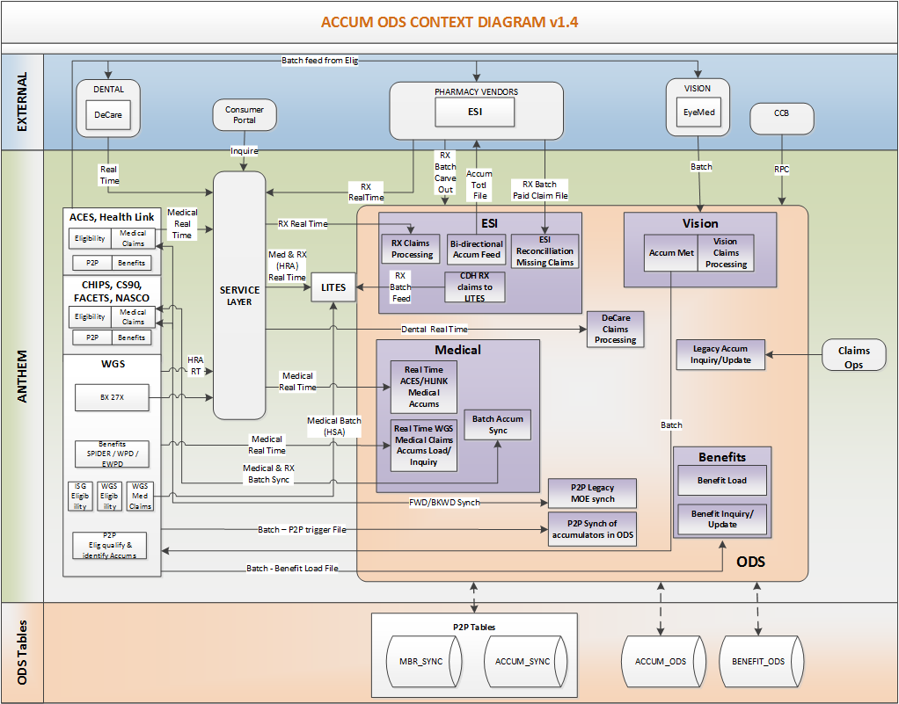
Current State

Slide 5
Problem 1 and Approach
Problem Statement: Current architecture doesn’t track all the accumulator transactions.
Cause | Resolution | Next Step
SPLUNK(the product used in SOA) is not registering all the transactions in the SOA layer | Tracking, Auditing, Reporting of transactions should be introduced | Check Micro service in-built logging facility can be used
 | Introduce auditing at the Accums back-end level | Check whether micro service in-built logging facility can be used.

Slide 6
Problem 2 and Approach
Problem Statement:
Duplicate records are getting updated in accum ODS creating incorrect claim payments resulting in adjustments.
Cause | Resolution | Next Step
During the real time updates from different systems, when the response is slow, source system might be informed with failure status as services have a cut off time to get the response. Because of this, source system will retry the transaction which results in double updates. | Track and remove duplicate transactions | Come up with solution to address the duplicate issues and check any of the micro service frame work can support to avoid duplicate transactions.
Peripheral application availability is causing accum call to fail from ESI, those applications don’t have direct dependency on the accumulator update | Remove IMS PCBs from Service Transactions from ESI and make it independent | Check SDS concept from microservices

Slide 7
Problem 2 Resolution
Introduce microservice architecture and create SDS for Accum ODS service. This will resolve network latency issue causing duplicate records during real time transactions.
Change WGS logic to access ODS through micro service layer. Existing WGS mainframe accumulator data structure will act like Data lake and support any batch processing happening. Daily data synch will be between SDS and Data lake ODS structure.

Slide 8
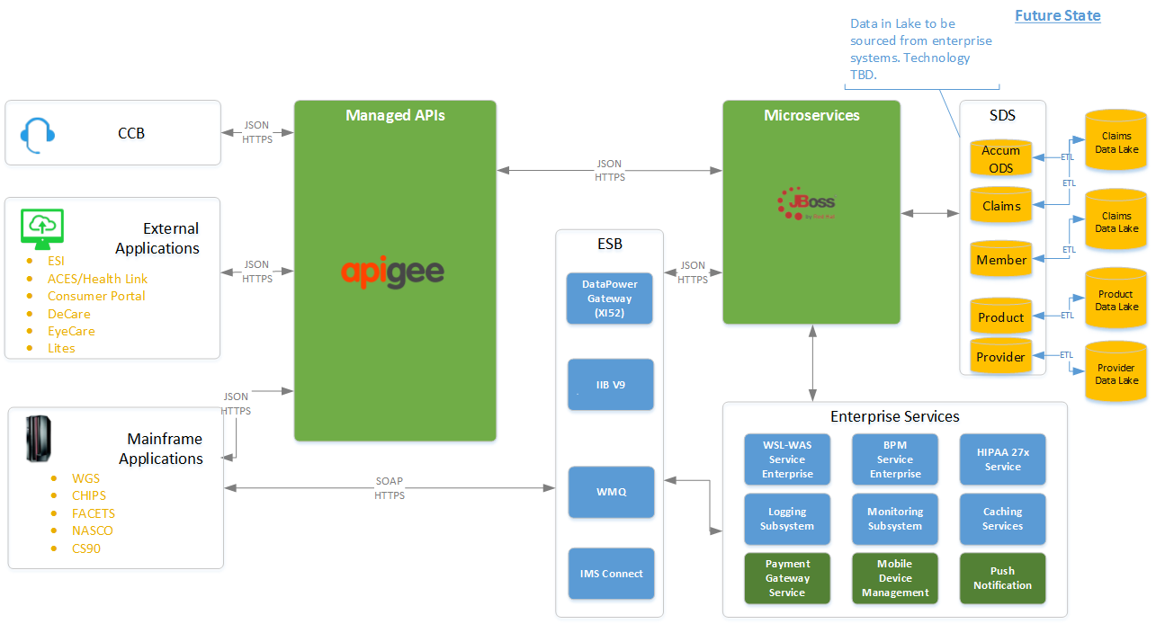
Problem 2 Resolution

Slide 9
Next Steps
WGS may introduce new risk due to accessing SDS through microservice causing network latency during adjudication process. This should be addressed through piloting.

